Slide 1

WEB PROJECT
PROPOSAL
Y3S1 IT WD 0102

Slide 2
Team.
Y3S1 IT WD 0102 REG WD IT 65
1 | Ransith N.P.V | IT22199430
2 | Nethmi I.W.D.A | IT22082756
3 | Perera D.K.S.D | IT22128522
4 | Ekanayake E.M.K.N | IT22104076

Slide 3
WHAT WE ARE WORKING ON
UI/UX
NEW FEATURES
FAST AND RELIABLE
User-friendly dashboards for
property, customer, transaction, and
maintenance management
Implement application that fullfill needs of use
Optimized database
queries for efficient
data retrieval

Slide 4
ABOUT THE PROJECT
Aftersales Maintenance Services
Most existing rental and land sale websites lack aftersales maintenance services. LANDORA aims to bridge this gap by providing comprehensive maintenance solutions, ensuring long-term support for property owners and tenants. Our system integrates property maintenance, vendor management, and automated scheduling to enhance post-sale experiences.

Slide 5
PROBLEMS AND MOTIVATIONS
POOR DESIGN
PROGRAMMING MISTAKES
LACK OF FEATURES

Slide 6
AIMS AND MOTIVATIONS
User friendly interface
Improve user satisfaction
Reach a wide audience

Slide 7






TECH STACK AND TOOLS
Mongo DB
Node JS
React JS
Database
Back – End
Database
Visual Studio Code
GitHub
Platform of the
develop the coding
Source code management, team collaboration and version control are managed using GitHub repository.

Slide 8
SYSTEM FUNCTIONS
1. Property Listing Dashboard
2. Customer Management Dashboard
3. Sales Management Dashboard
4. Maintenance Management System
4. User Management System

Slide 9



THE TEAM
JENNA DOE
JOHN DOE
JIMMY DOE
JENNA DOE
You can replace the image on the screen with your own
You can replace the image on the screen with your own
You can replace the image on the screen with your own
You can replace the image on the screen with your own

Slide 10
OUR GOALS
EXPANSION
POSITIONING
USABILITY
Neptune is the fourth-largest planet in our Solar System
Venus has a beautiful name and is the second planet from the Sun
Despite being red, Mars is a cold place, not hot. It’s full of iron oxide dust

Slide 11
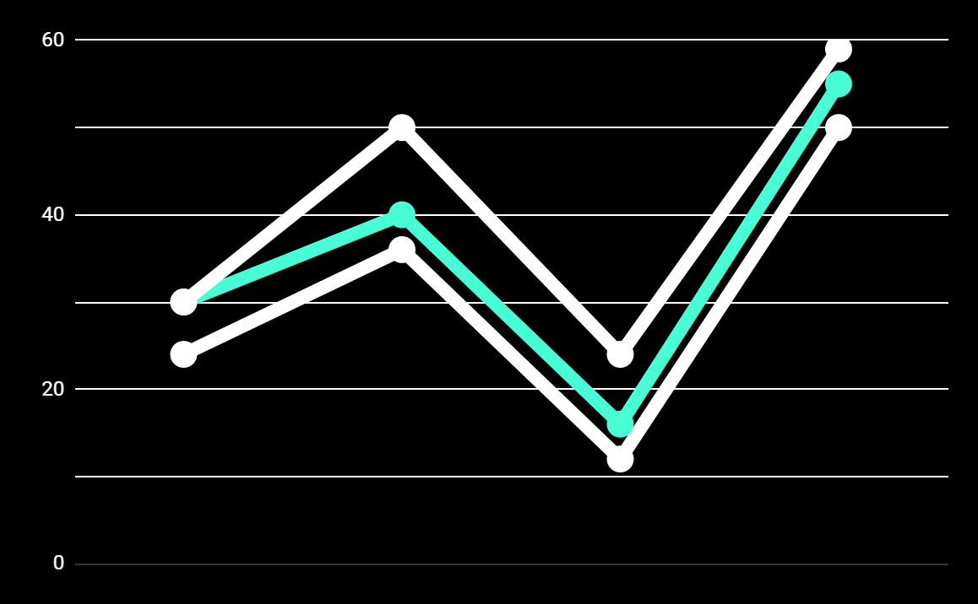
PREDICTED RESULTS
CONVERSIONS NEXT YEAR
+20%
MONTHLY VISITS
+33%
CONVERSION RATE
+40%
ANNUAL ORDERS

Slide 12
A VIDEO IS A GOOD IDEA
Insert your multimedia content here

Slide 13
THANKS!
Does anyone have any question?
addyouremail@freepik.com
+91 620 421 838
yourcompany.com

